Slide 1
Creating Virtual Worlds
ICE
V. Jurenka

Slide 2
Top Level Architecture
Editor
most complex system
many libraries (jGraphX, SwingX, JOPS, …)
Server
doesn’t utilitise OpenGL / LWJGL or JME
performance is crucial
Client
“dumb”, only creates request and displays data from network
purely for demonstration
Additional Tools
Dialog editor
Login server
Update server
will be integrated to Editor later

Slide 3
Core Systems
Network
Persistence
Terrain
Managing entities
Particle systems
AI

Slide 4
Network Overview

Slide 5
Network issues
Security
All logic on server
Chat messages are also private data
RSA for login, AES later
Synchronisation
One interface for changing 7 attributes
Threading
Thread per client
Currently on TCP, but UDP is implemented too

Slide 6
Persistence
Hibernate

Slide 7
Terrain
Need to be both large and detailed
Modelled terrain
Detailed, but not large ☹
Procedural terrain
Large, but not detailed ☹
Real world terrain
Google data
Hard and slow to extract
Random searching
Limited selection
Satellite data from United States Geological Survey
Almost perfect, but really large files and made for spheres, not planes
Convert VTBuilder -> Grayscale -> Blur -> Slice -> Enlarge
Still needed separate smooting
Then blending the sliced pieces on edges

Slide 8
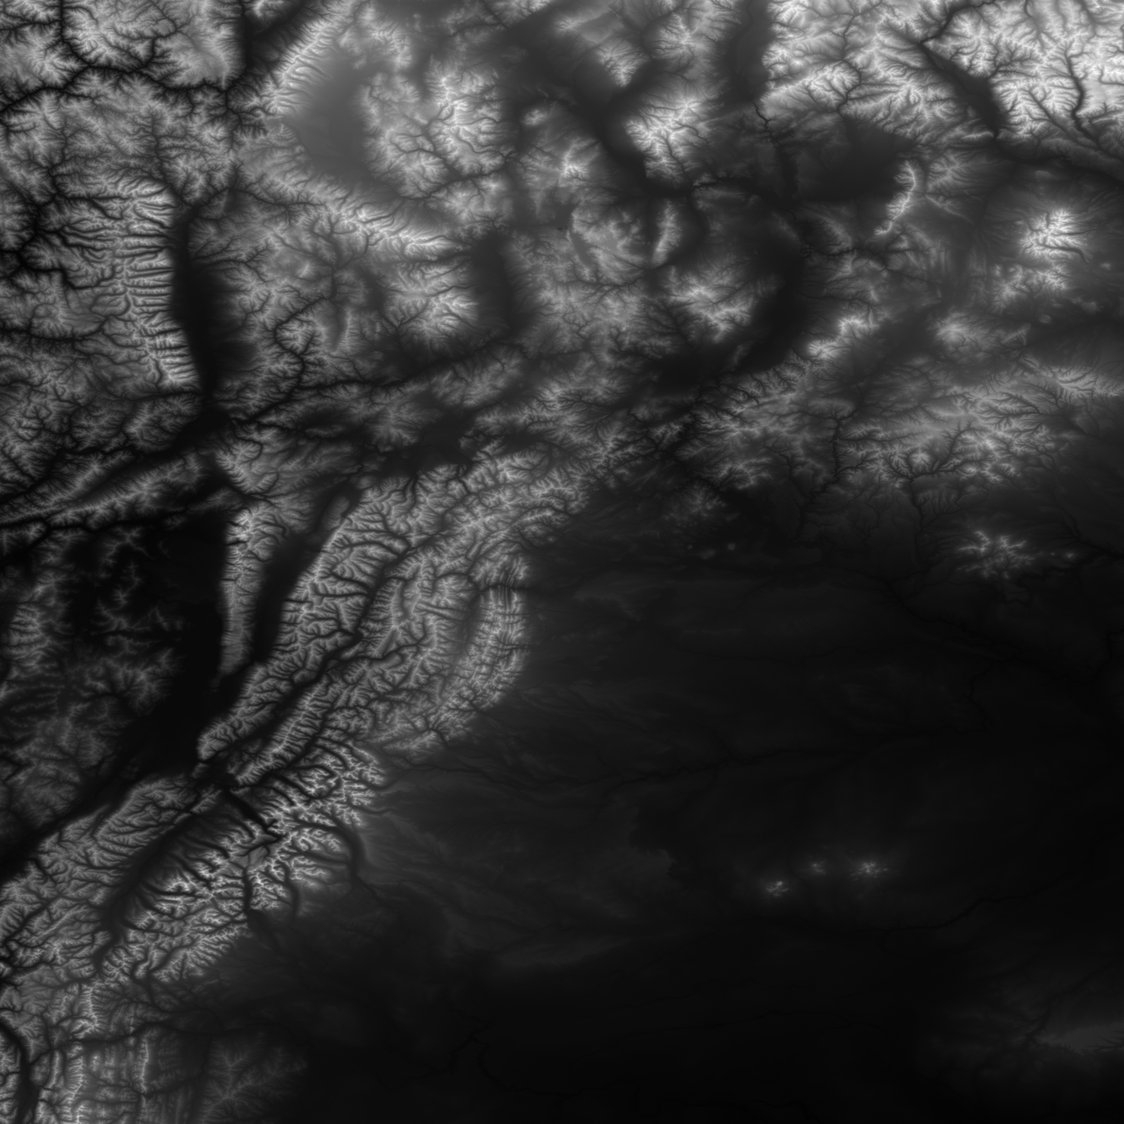

Slide 9
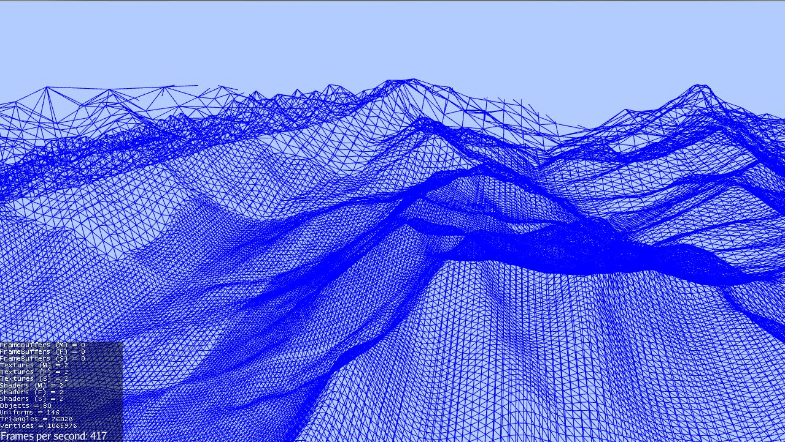

Slide 10
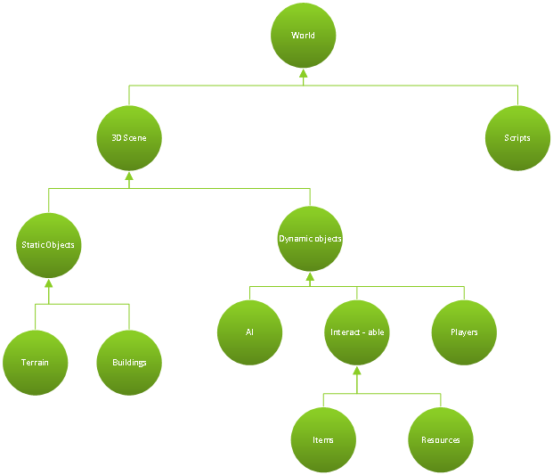
Managing entities
What can collide?
What is visible?
Custom QuadTree
OctTree is overkill
R-Tree is slow for updating

Slide 11
Particle Systems
Java open particle system
Uses Xith for visualisation - incompatible ☹
No API documentation ☹
Comments in code are in French ☹
But creates beautiful effects ☺
Input
Origin
Generator
Particle
Origin animation
Particle Animation
Output
Vertex & Color buffer

Slide 13
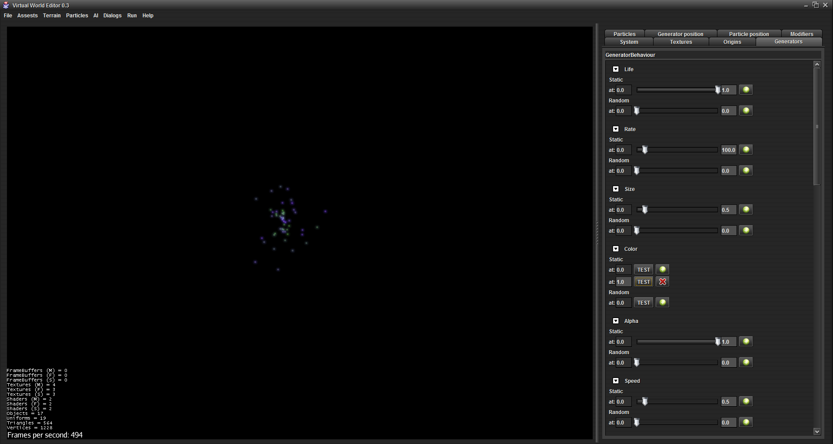

Slide 14
AI
5 Layers for better separation
Finite State Machine
Behavioral Tree
Synchronisation layer
Higher Algorithmic layer
Lower Algorithmic layer

Slide 15
FSM
Top level of behavior
“Idle”, “Threatened”, “Alarmed”, “Hungry”
Contain BT in each node
Helps avoiding large and complicated BTs
State changed on event or on condition

Slide 17
Behavioral Trees
Contain “logic”
Can model very complex behaviors
Easy to read
Simple to modify
4 Types of nodes
Sequence
Any
Parallel
Random
Decorator
2 Types of leaves
Condition
Action

Slide 19
Synchronisation
Some tasks takes time
Animation, sound, pathfinding, movement
Thread per tree
Results in thread per task
Custom benchmark
Spawning threads is slow
They mostly only wait
It took 2,7s for 1000 threads to wait 2s
Wrapping actions
complicated
limits possibilities
Software threads / Custom scripting language
Slow
Hard to implement
Node locks
Solves problems with Parallel
One thread

Slide 20
Higher algorithms
Asynchronous
Pathfinding
Is implemented as service -> may use different server
Two parts
A* on precomputed Navigation mesh
Creates “jagged” path
Funnel algorithm minimalises turns

Slide 21
Navmesh
Simplified scene model
Full size 192*2000*2000*2 = 10^9 triangles
Won’t even fit in RAM
Navmesh size ~ 10^5 triangles
Customisable walkable areas
Consists of triangles and portals between
Generated using java port of Recast
Had to generate for each square separately
Later merged on edges using custom script
Portals can lead to areas which aren’t connected via geometry (interiors)

Slide 22
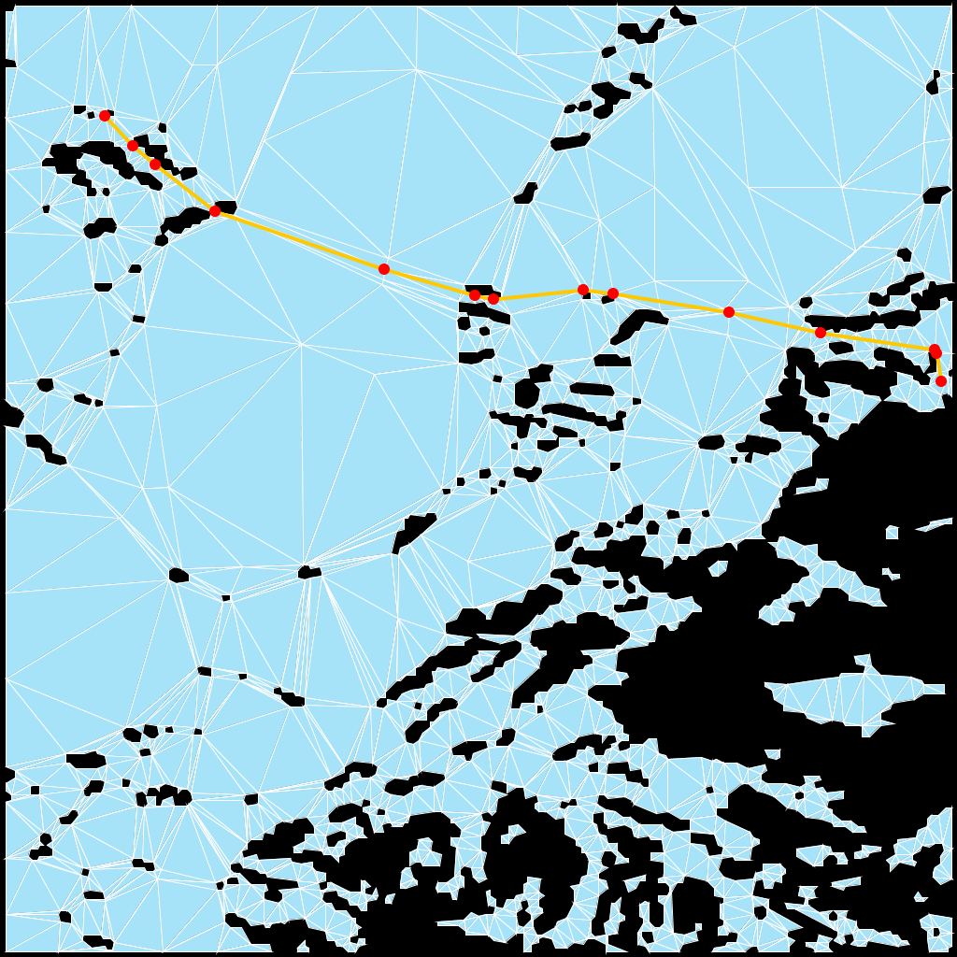

Slide 23
Lower algorithms
Synchronised
Called by engine on each “tick”
Movement physics
Velocity
Acceleration
Steering pipleline
Goals, Targeters, Decomposers, Constaints, Actuators, …boring
Avoiding collisions with unpredicted obstacles
Evading moving objects
Following path or other entity

Slide 24
AI Logic

Slide 25
Scene Editor
User friendly way of editing scene
Location, rotation, scale of course
Loading models
Auto placement on terrain
Some rendering attributes
Radius for collisions

Slide 26
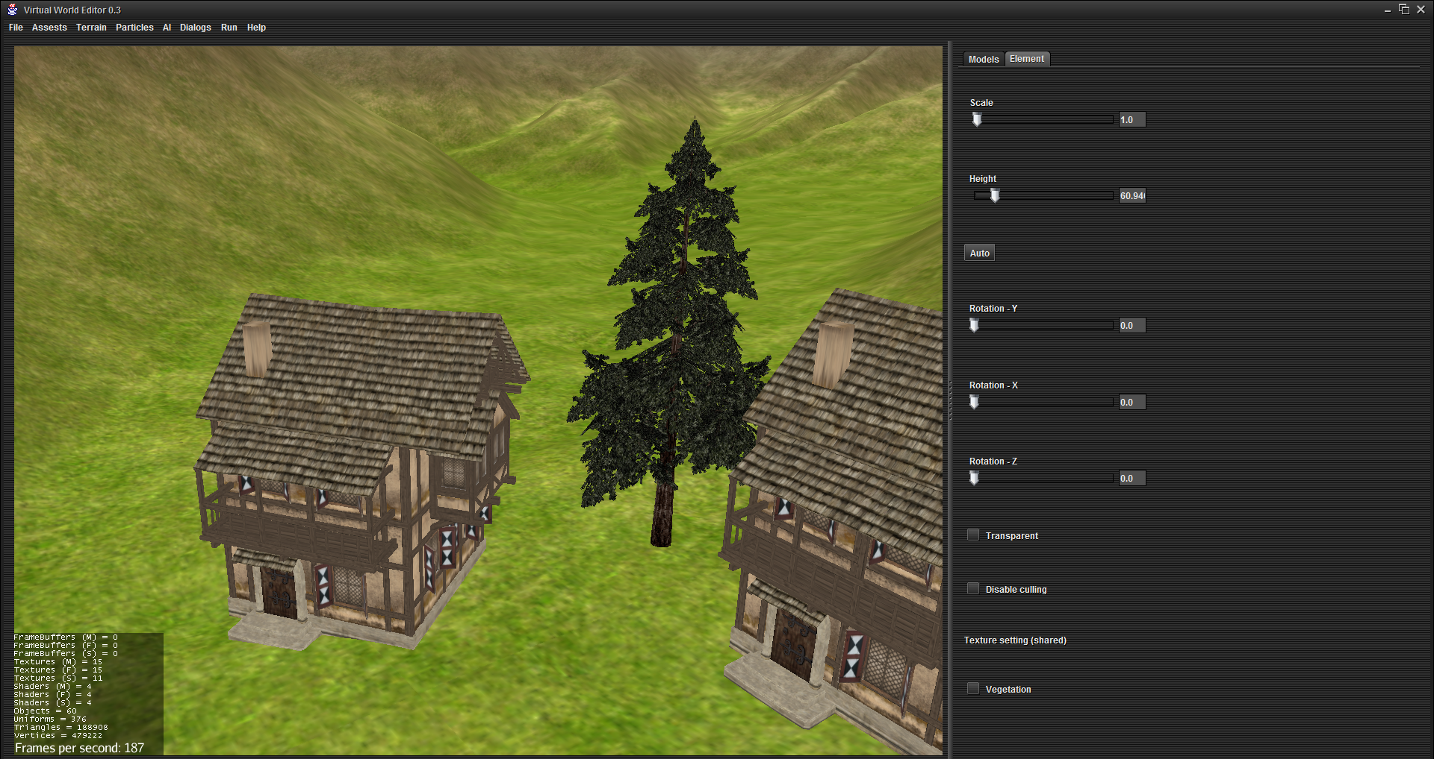

Slide 27
Dialog editor
Custom system with xml notation
Line->response(s)->line
Line can be split among several frames
Different responses can lead to different lines
Reponses can be conditioned
Lines can trigger actions
Editor will need some touch
Both command line and graphical interpreter

Slide 28
What needs to be done
Interior editing (current priority)
Item system editor
Quest system editor
Particle system editor (50% done)
Save/Load for scene
Persistence for server
Sounds and scripts placement
Make the AI actually do something intelligent
Entire client (can largely reuse old code)

